Slide 1
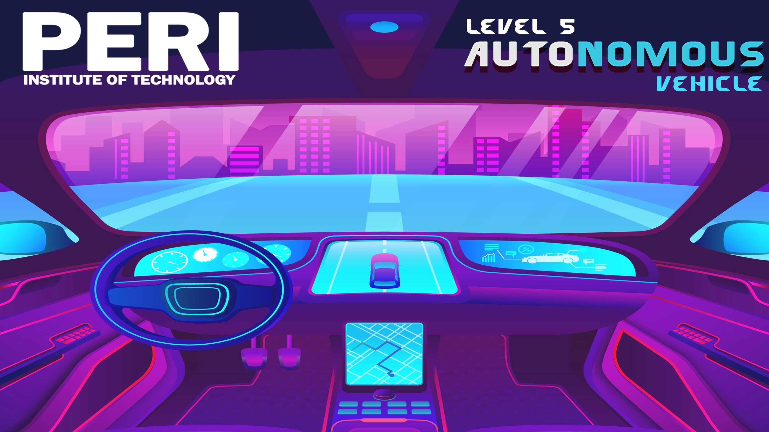
www.peri.education
www.periit.com

Slide 2

OBJECTIVE
Autonomous cars are the future smart cars anticipated
to be driver less, efficient and crash avoiding ideal urban
car of the future. To reach this goal automakers have started
working in this area to realized the potential and solve the
challenges currently in this area to reach the expected outcome.
This car is capable of sensing the environment, navigating
and Fulfilling the human transportation capabilities without any
human input. It is a big step in the advancing future technology.
The development and expansion of the sector in Indian conditions
is also worth considering.
We strongly believe that the autonomous
car will be a reality soon and be a necessity of life by overcoming
the current obstacles, as human life needs to be secured by safe,
efficient, cost effective and comfortable means of transport.

Slide 3
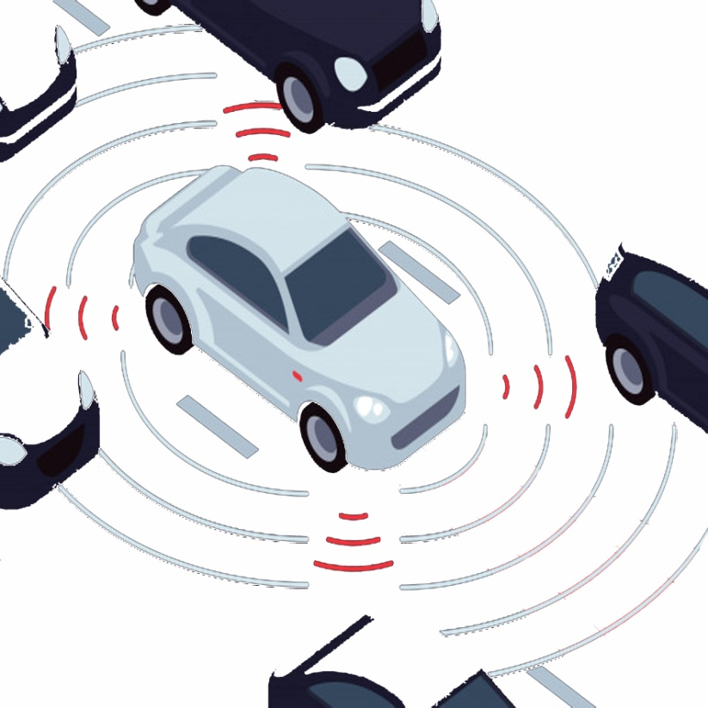
OPERATION
Autonomous cars sense their surroundings with cameras,
radar, LIDAR, GPS and navigational paths. Advanced control systems
interpret sensory information to keep track of their position even
though the conditions change.
The advantages of autonomous cars, such as fewer traffic
collisions, increased reliability, increased roadway capacity, reduced
traffic congestion as well as reduction of traffic police and care insurance,
are compulsive for the development of autonomous car even though
we have to overcome the issues of cyber security, software reliability,
liability of damage and loss of driver related jobs.
Autonomous cruise control or the Lane departure warning system and
the Anti lock braking system (ABS) are the early steps. These steps though
small are conclusive towards the progress in the direction of
making the autonomous car. Companies such as Google, Volvo, Mercedes
Benz and Audi are the fore runners in making the autonomous car a reality.

Slide 4
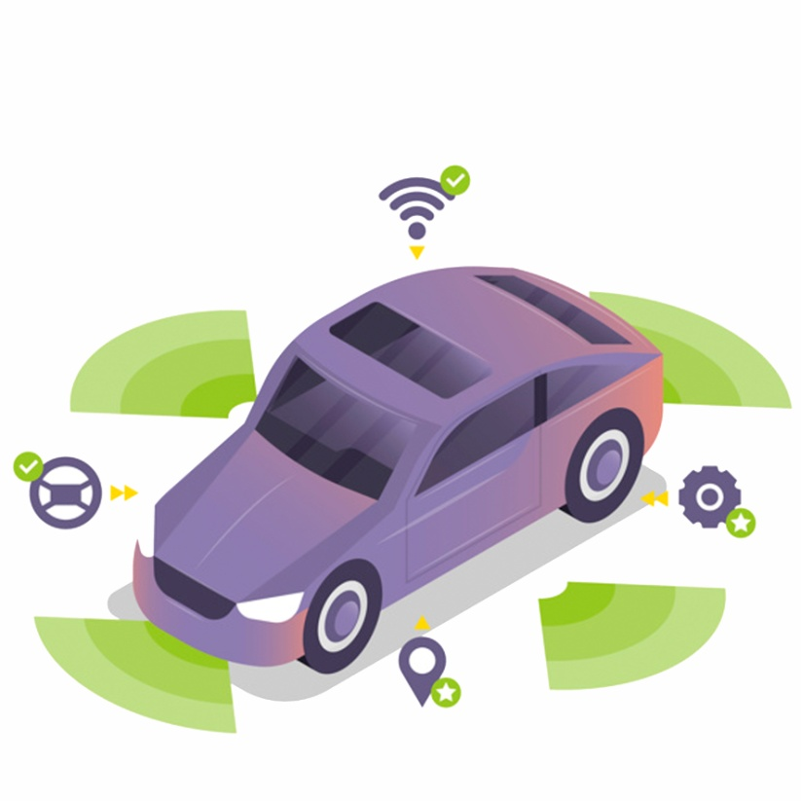
PURPOSE
The Purpose of autonomous cars, such as fewer traffic
collisions, increased reliability, increased roadway capacity, reduced
traffic congestion as well as reduction of traffic police and care
insurance, are compulsive for the development of autonomous car even
though we have to overcome the issues of cyber security, software
reliability, liability of damage and loss of driver related jobs.
We strongly believe that the autonomous car will be a reality
soon and be a necessity of life by overcoming the current obstacles, as
human life needs to be secured by safe, efficient, cost effective and
comfortable means of transport.

Slide 5
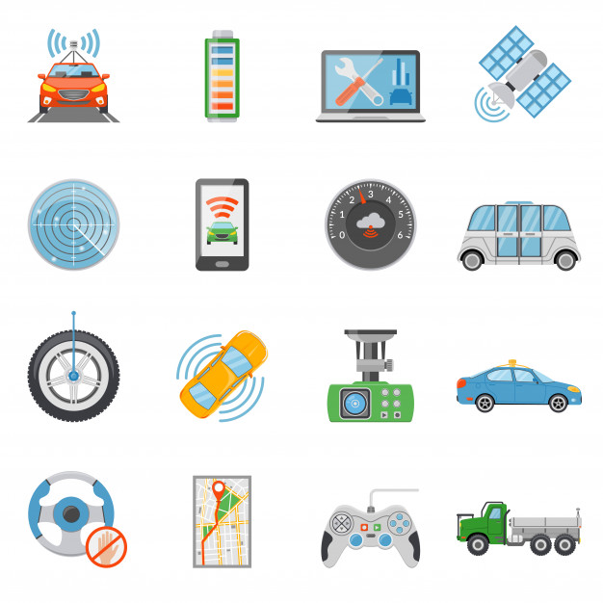
COMPONENTS
Vehicle - 450000
Vehicle conversion - 150000
Raspberry pi 4 - 30000
LIDAR (12) - 80000
Ultrasonic (12) - 30000
LCD display - 25000
Camera (4) - 200000
GPS - 10000
RADAR - 350000
Software license - 250000
Programming - 200000
Other components - 200000
Load sensor(4) - 20000
total cost is approximately 20 lakh

Slide 6
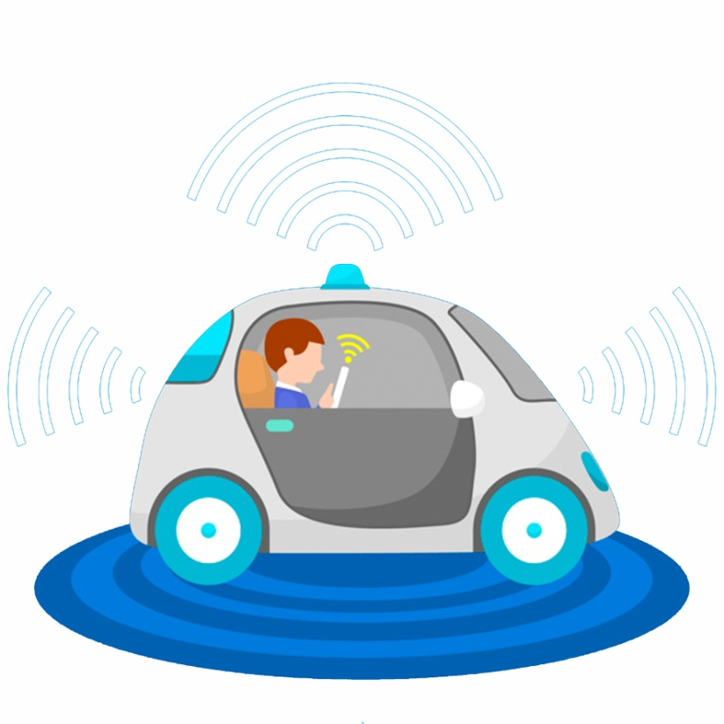
SPECIFICATIONS
Tracks will be created for the car to detect and follow. We expect the sensors to have a quick reaction so that it can follow the track instead of going off track.
It can stop when obstacles are ahead. Then go again when obstacles are removed.
The maximum speed of the car can be adjusted. We may adjust by changing the code and we will determine the maximum speed it can reach to prevent going off track.

Slide 7

MARKET POTENTIAL
Automation costs only about 3.5 lakh above the actual cost of the car.
Actual of total cost is approximately 20 lakh
The global autonomous vehicle market size is projected to be valued at $54.23 billion in 2019, and is projected to garner $556.67 billion by 2026, registering a CAGR of 39.47% from 2019 to 2026.

Slide 8
WORK FLOW
Start
Project Selection
& Project design
Basic Implementation of Project
Project Work Model &
Report Work
Project result & Report Submission
End

Slide 9
CONCLUSION
Vehicular communication systems are an emerging type of networks in which vehicles and roadside units are the communicating nodes, providing each other with information such safety, warnings and traffic information.
Autonomous car integrated with vehicular communication systems can be more effective in avoiding crashes and traffic congestion

Slide 10

www.peri.education www.periit.com
PERI Knowledge Park, Mannivakkam, Chennai - 600048

